Slide 1
N. Rizk
COSC 3337 : Data Science I
College of Natural and Applied Sciences
Department of Computer Science
University of Houston

Slide 2

“Machine learning is the field of study that gives computers the ability to learn without being explicitly programmed”
— Arthur L. Samuel, AI pioneer, 1959
Machine
Learning
1

Slide 3
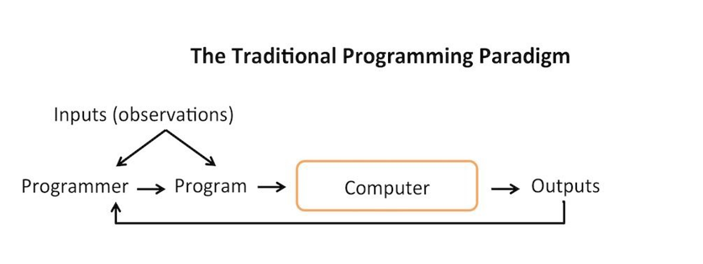
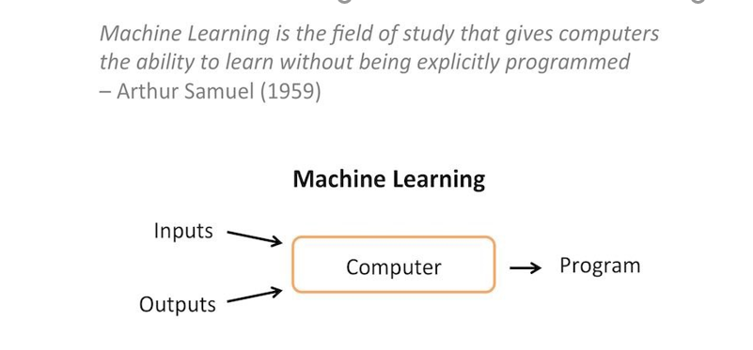

Slide 4
Learning
“A computer program is said to learn from experience E with respect to some class of tasks T and performance measure P , if its performance at tasks in T , as measured by P , improves with experience E.”
— Tom Mitchell, Professor at Carnegie Mellon University
Learning in this context is the process of gaining understanding by constructing models of observed data with the intention to use them for prediction.

Slide 5
Categories of Machine Learning
Labeled data Direct feedback
Predict outcome/future
Supervised Learning

Slide 6
Supervised Learning: Classification
x₂
x₁

Slide 7















Supervised Learning: Regression
y
x

Slide 8
Categories of Machine Learning
Labeled data Direct feedback
Predict outcome/future
Supervised Learning
No labels/targets No feedback
Find hidden structure in data
Unsupervised Learning

Slide 9
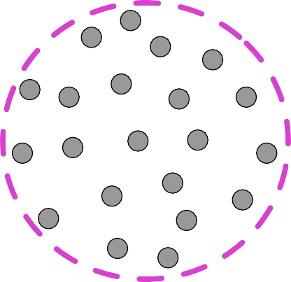
Unsupervised Learning - Clustering
x₂
x₁

Slide 10
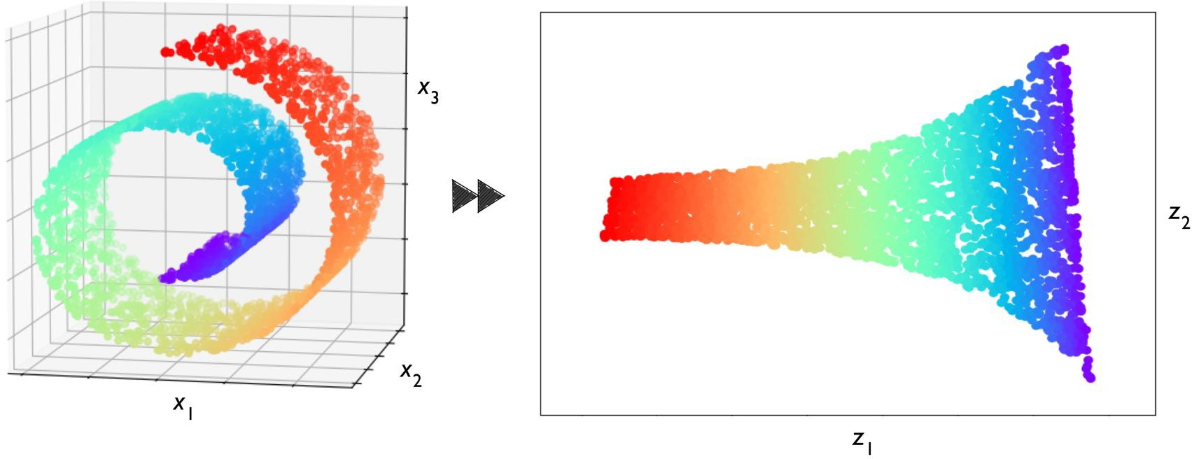
Unsupervised Learning: Dimensionality Reduction

Slide 11
Categories of Machine Learning
Labeled data Direct feedback
Predict outcome/future
Supervised Learning
No labels/targets No feedback
Find hidden structure in data
Unsupervised Learning
Decision process Reward system
Learn series of actions
Reinforcement Learning

Slide 12
Reinforcement Learning
Environment
Reward
State
Action
Agent

Slide 13
Supervised Learning Workflow
Labels
Training Data
Machine Learning Algorithm
New Data
Predictive Model
Prediction

Slide 14
Supervised Learning Workflow
Detailed
Feature Extraction and Scaling Feature Selection Dimensionality Reduction Sampling
Labels
Training Dataset
Learning Algorithm
Labels
Final Model
New Data
Labels Prediction
Raw
Test Dataset
Data
Preprocessing
Learning
Evaluation
Model Selection Cross-Validation Performance Metrics
Hyperparameter Optimization

Slide 15
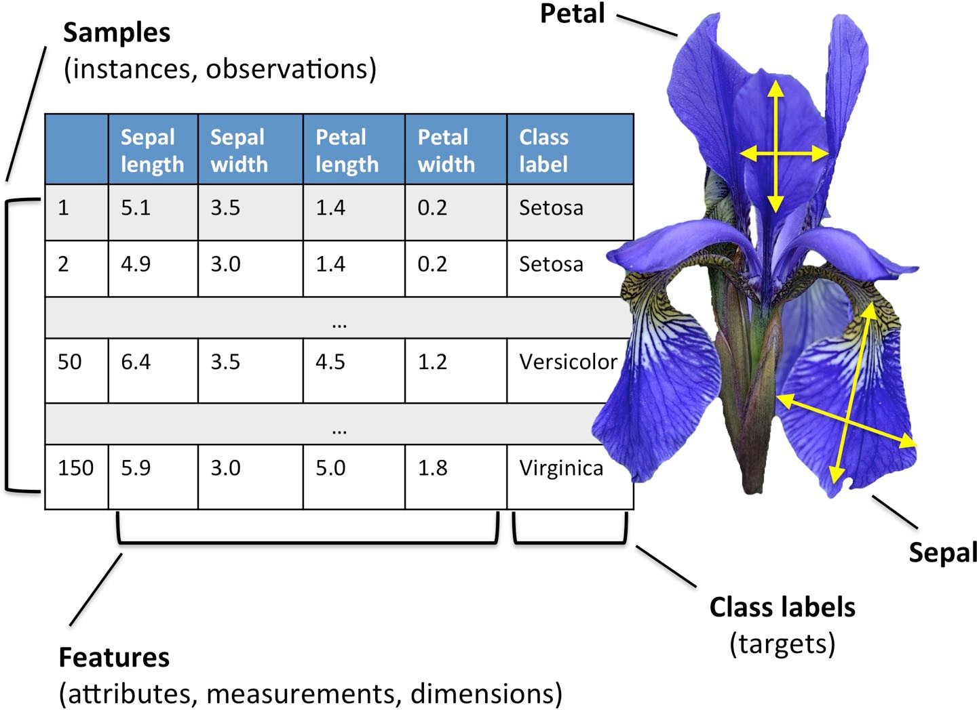

Data Representation
IRIS data set

Slide 16
5 Steps for Approaching an Application
Define the problem to be solved.
Collect (labeled) data.
Choose an algorithm class.
Choose an optimization metric for learning the model.
Choose a metric for evaluating the model.

Slide 17
Objective Functions
Maximize the posterior probabilities (e.g., naive Bayes)
•
Maximize a fitness function (genetic programming)
•
Maximize the total reward/value function (reinforcement learning)
•
Maximize information gain/minimize child node impurities (CART decision tree classification)
•
•
Minimize a mean squared error cost (or loss) function (CART,
decision tree regression, linear regression, adaptive linear neurons, ...)
•
Maximize log-likelihood or minimize cross-entropy loss (or cost) function
•
Minimize hinge loss (support vector machine)

Slide 18
Metrics
Accuracy (1-Error) ROC AUC
Precision Recall
(Cross) Entropy Likelihood
Squared Error/MSE L-norms
Utility Fitness
...
•
•
•
•
•
•
•
•
•
•
•

Slide 19
Categorizing Machine Learning Algorithms
Lazy : K - Nearest Neighbor, Case - Based Reasoning
Eager : Decision Tree, Naive Bayes, Artificial Neural Networks
Lazy learner:
Just store Data set without learning from it
Start classifying data when it receive Test data
So it takes less time learning and more time classifying data
Eager vs Lazy;
Eager learner:
When it receive data set it starts classifying (learning)
Then it does not wait for test data to learn
So it takes long time learning and less time classifying data

Slide 20
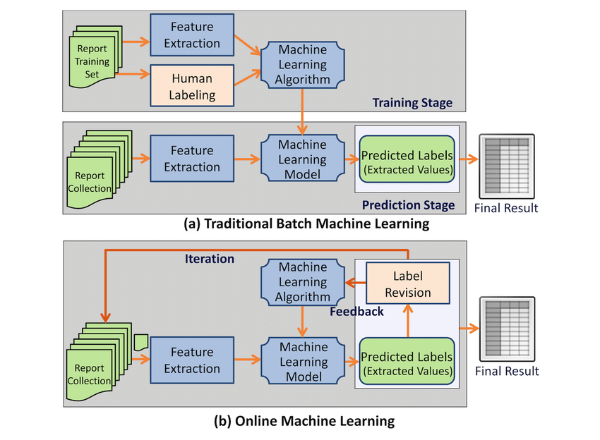
Categorizing Machine Learning Algorithms
Online: Learning based on each pattern as it is observed.
Batch: Learning over groups of patterns. Most algorithms are batch.
Eager vs Lazy;
Batch vs Online;

Slide 21
Categorizing Machine Learning Algorithms
The trade-offs between parametric and non-parametric algorithms are in computational cost and accuracy.
A non-parametric algorithm uses a flexible number of parameters, and the number of parameters often grows as it learns from more data. A non-parametric algorithm is computationally slower:KNN
Eager vs Lazy;
Batch vs Online;
Parametric vs Nonparametric;
A parametric algorithm has a fixed number of parameters. A parametric algorithm is computationally faster, but makes stronger assumptions about the data: Linear Regression

Slide 22
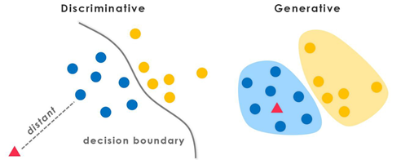
Categorizing Machine Learning Algorithms
Eager vs Lazy;
Batch vs Online;
Parametric vs Nonparametric;
Discriminative vs Generative.
Discriminative models try only to understand how classes are separated based on the attributes (more on this later).
Generative models try to understand the probability distribution of the data (x,y)

Slide 23
Goals in Analyzing data
Case 1:
x
y
Prediction. To be able to predict what the responses are going to be to future input variables
Information. To extract some information about how the algorithm is associating the response variables to the input variables.

Slide 24
Goals in Analyzing data
Case 2
x
linear regression logistic regression Cox model
y
The values of the parameters are estimated from the data and the model then used for information and/or prediction. Thus the black box is filled in like this:
Model validation. Yes–no using goodness-of-fit tests and residual examination.

Slide 25
Goals in Analyzing data
Case 3
x
Unknown
y
Decision Trees
Neural Nets
Model validation. Measured by predictive accuracy.
The analysis in this culture considers the inside of the box complex and unknown. Their approach is to
find a function f→x)—an algorithm that operates on x to predict the responses y

Slide 26
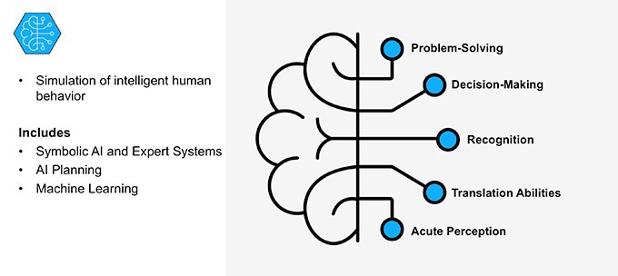
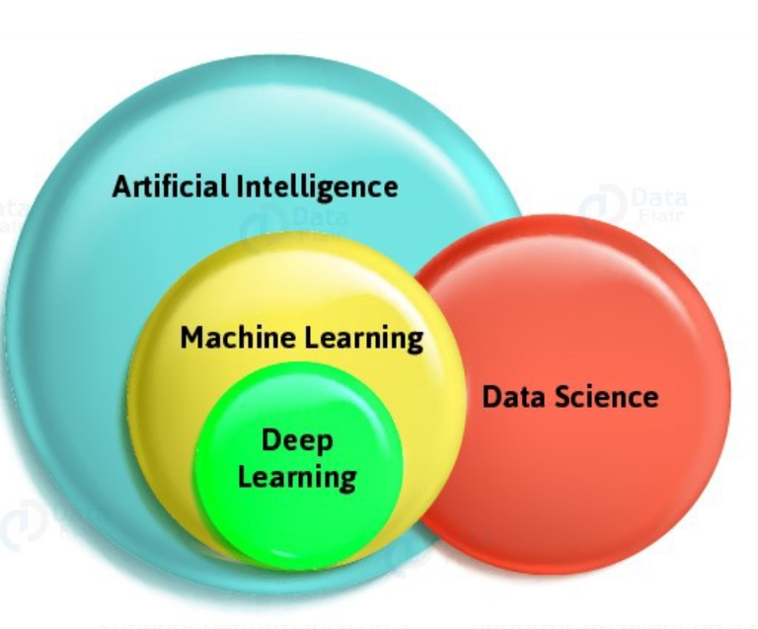
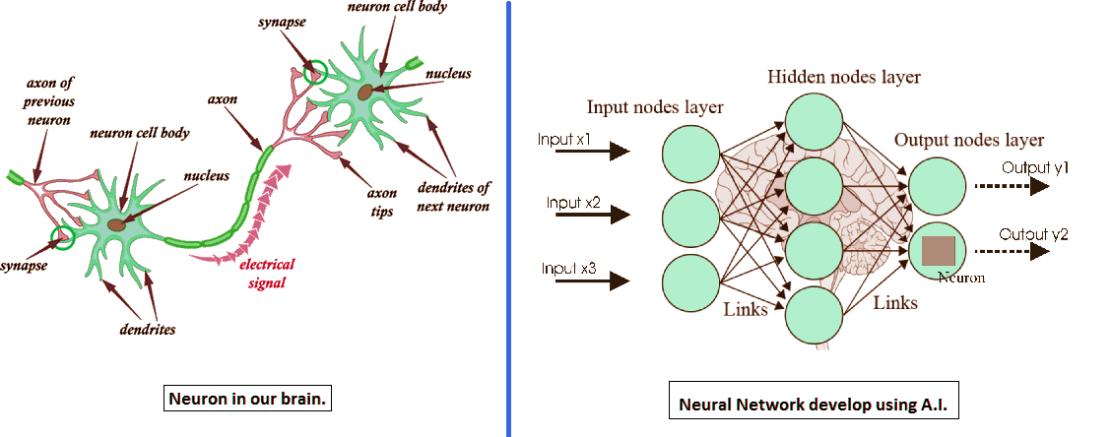
Machine Learning, AI, Deep Learning, and DATA SCIENCE
Data science is a multidisciplinary term for a whole set of tools and techniques of data inference and algorithm development to solve complex analytical problems.
Artificial Intelligence is a comprehensive term; it is conveying a cognitive ability to a machine.
Machine Learning deals with the listed below issues:
Analyze data
Collect data
Filter data
Train algorithms
Test algorithms
Use algorithms for future predictions
The data science life cycle has six different phases:
1. Discovery
2. Data preparation
3. Model planning
4. Model building
5. Communicating results
6. Operationalizing
Deep Learning is an approach to Machine Learning that is recognized via neural networks.

Slide 27
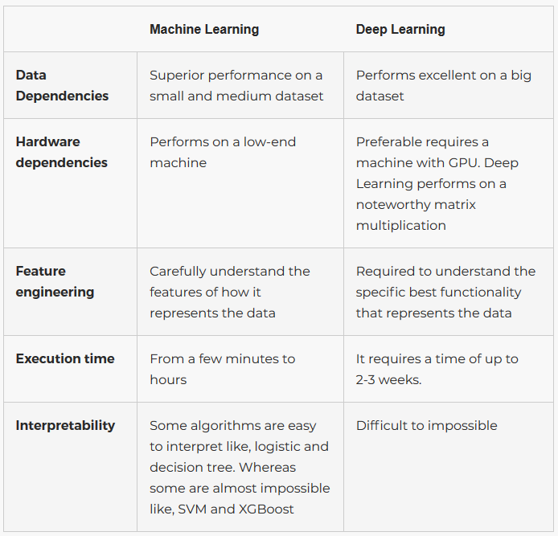

Slide 28
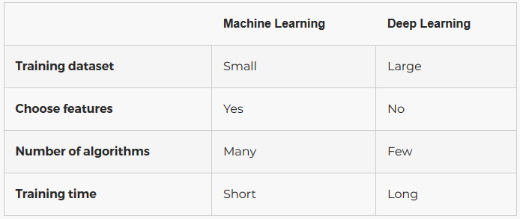
Machine Learning vs Deep Learning

Slide 29
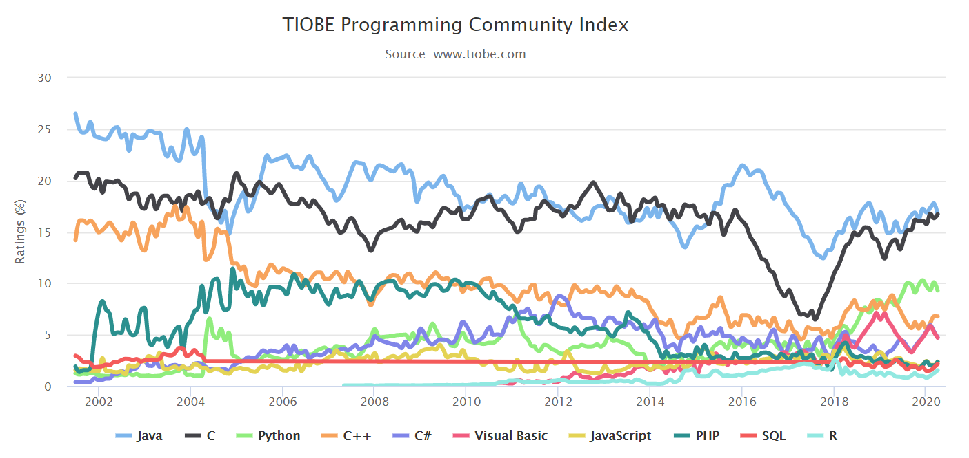
Why Python?

Slide 30
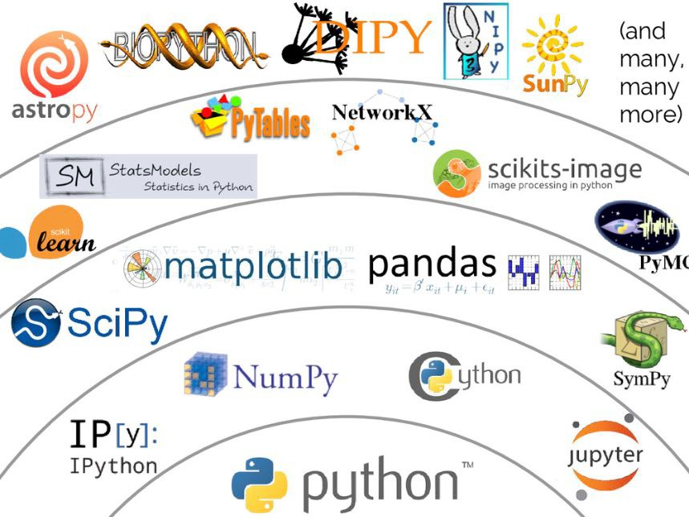
Python Libraries
Image by Jake VanderPlas; Source:
https://speakerdeck.com/jakevdp/the-state-of-the-stack-scipy-2015-keynote?slide=8)

